Slide 1



A Multi-Agent Generative AI Platform for Multi-Morbidity Conflict Resolution and Medication–Diet Interaction Verification
Guided by:
Dr Nithisha J
Presented By
N.Goutham(192472024) N.Chaitanya Ram(192472172)
M.Mohamed Bazith(192472052)
Hemanth(192472285)

Slide 2


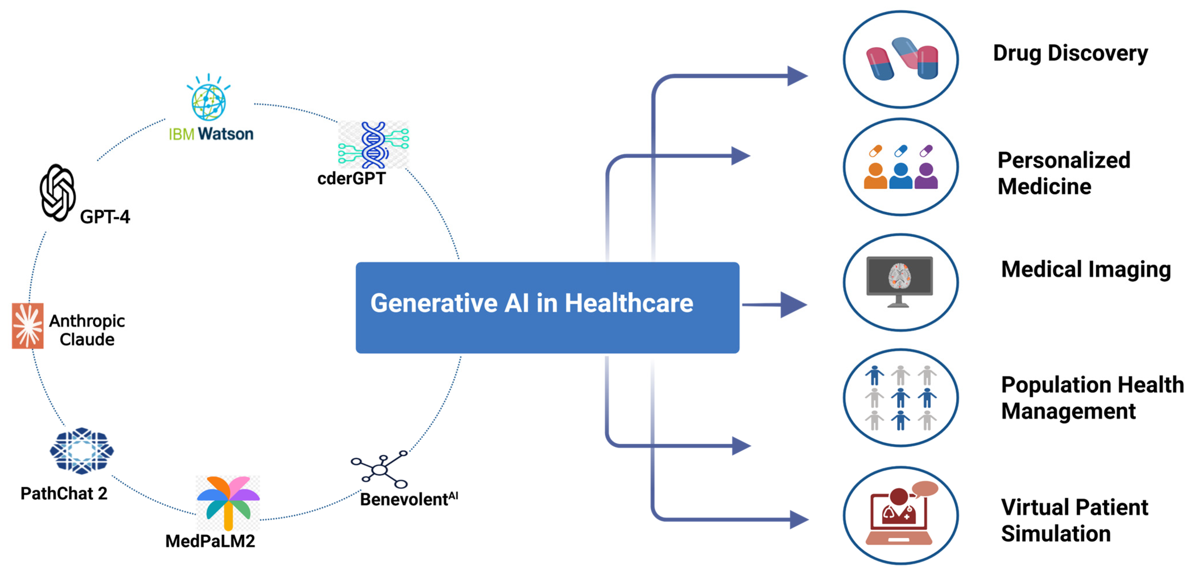
INTRODUCTION
Multi-morbidity patients require coordinated healthcare management system.
Multiple medications increase the risk of harmful interactions conflicts.
Diabetes, hypertension, and kidney disease require different medications simultaneously.
Manual verification is slow, causing side effects and reduced treatment effectiveness.
Multi-Agent AI analyzes diseases, medications, and diet, while Generative AI provides personalized healthcare recommendations and reports.

Slide 3
PROBLEM STATEMENT
Patients commonly experience multiple chronic diseases requiring simultaneous treatments.
Different prescriptions frequently create dangerous medication interaction conflicts unintentionally.
Medication and dietary incompatibilities remain unnoticed during routine treatments.
Existing healthcare platforms lack integrated intelligent conflict detection capabilities.
Manual verification increases workload while reducing healthcare decision efficiency.
Personalized dietary guidance remains unavailable for most chronic disease patients.

Slide 4

EXISTING SYSTEM
Doctors manually verify medications using separate healthcare reference resources.
Drug interaction checking requires significant clinical experience and expertise.
Nutrition recommendations remain independent from medication verification procedures.
Existing systems provide limited personalized healthcare decision support services.
Healthcare professionals spend excessive time analyzing multiple medical records.
Traditional platforms rarely integrate intelligent AI healthcare recommendations effectively.

Slide 5
PROPOSED SYSTEM
Develop intelligent Multi-Agent AI healthcare decision support platform completely.
Collect comprehensive patient medical and medication information securely stored.
Analyze multiple diseases using specialized collaborative intelligent AI agents.
Detect medication conflicts using trusted healthcare knowledge databases accurately.
Generate personalized nutrition recommendations based on patient medical conditions.
Produce comprehensive AI-powered healthcare reports supporting clinical decision making.

Slide 6
OBJECTIVES
Detect conflicts among multiple chronic diseases accurately and efficiently.
Verify drug interactions using trusted medical knowledge databases automatically.
Identify medication and dietary compatibility for improved patient safety.
Generate personalized meal recommendations based on individual medical conditions.
Assist healthcare professionals through intelligent AI decision support systems.
Improve treatment quality while reducing adverse healthcare interaction risks.

Slide 7
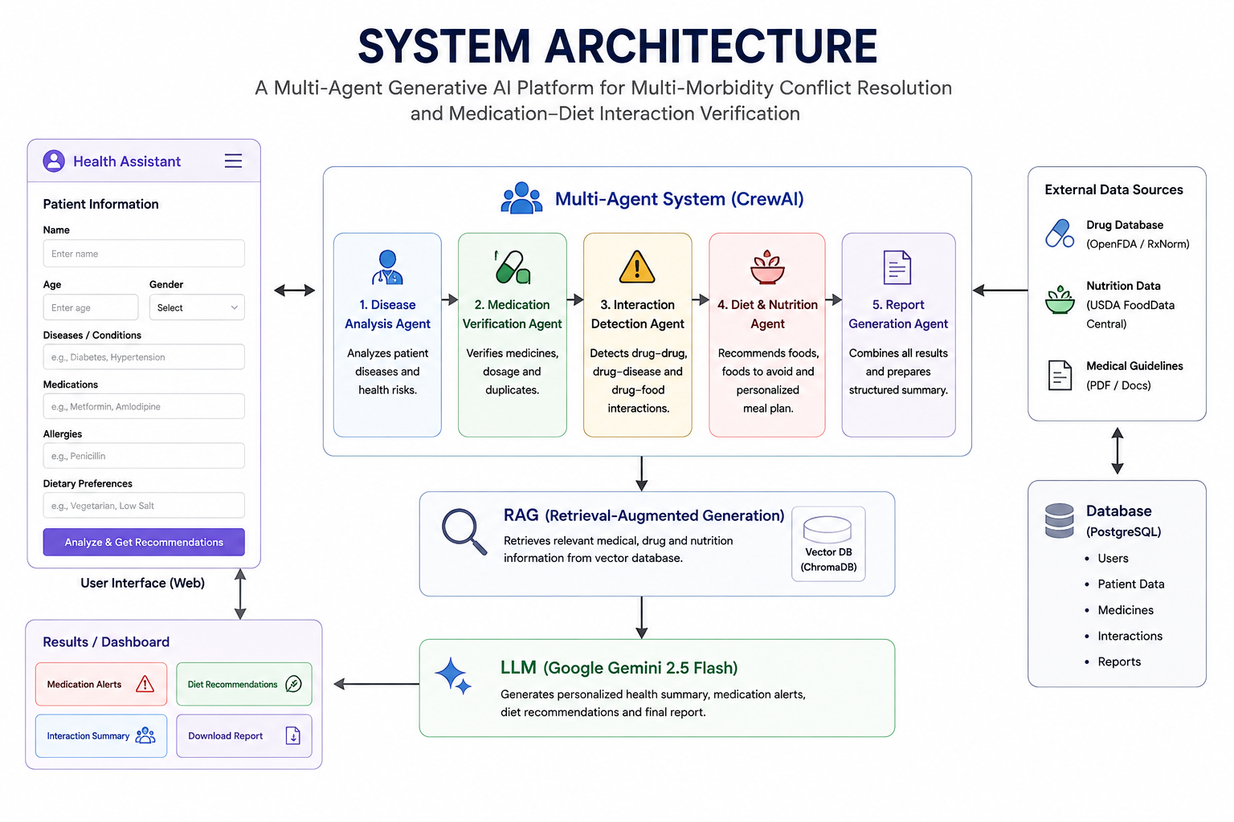
SYSTEM ARCHITECTURE

Slide 8
Module 1 : Patient Health Profile & Disease Management
Register patients using secure authentication and profile management system.
Collect patient demographics including age, gender, height, and weight.
Record medical history, allergies, and lifestyle information securely.
Store multiple chronic diseases with complete patient health records.
Maintain centralized healthcare database for future medical analysis.
Create comprehensive patient profile supporting intelligent AI healthcare decisions.

Slide 9
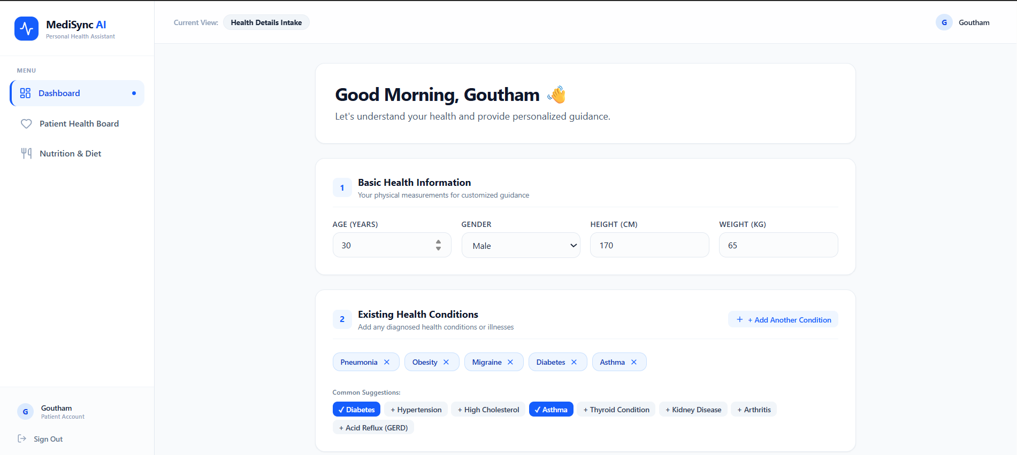
Module 1 : Patient Health Profile & Disease Management

Slide 10
Module 2 : Multi-Agent Conflict Detection
& Medication Verification
Analyze prescribed medications using specialized intelligent healthcare AI agents.
Verify medicine dosage using trusted pharmaceutical reference databases accurately.
Detect harmful drug–drug interactions affecting patient treatment safety.
Identify drug–disease conflicts based on patient health conditions.
Generate medication safety alerts with interaction severity classification levels.
Recommend safer medication alternatives supporting improved clinical decision making.

Slide 11
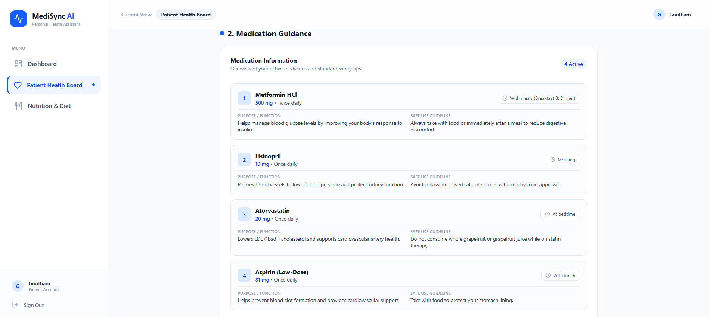
Module 2 : Multi-Agent Conflict Detection
& Medication Verification

Slide 12
Module 3 : Medication–Diet Interaction Verification
& Personalized Nutrition
Analyze dietary habits based on medications and medical conditions.
Detect harmful medication–food interactions using trusted nutrition databases.
Recommend personalized diet plans supporting healthier patient recovery outcomes.
Suggest suitable food alternatives based on individual health conditions.
Generate balanced meal schedules matching prescribed medications and diseases.
Improve treatment effectiveness through intelligent nutrition recommendations and guidance.

Slide 13
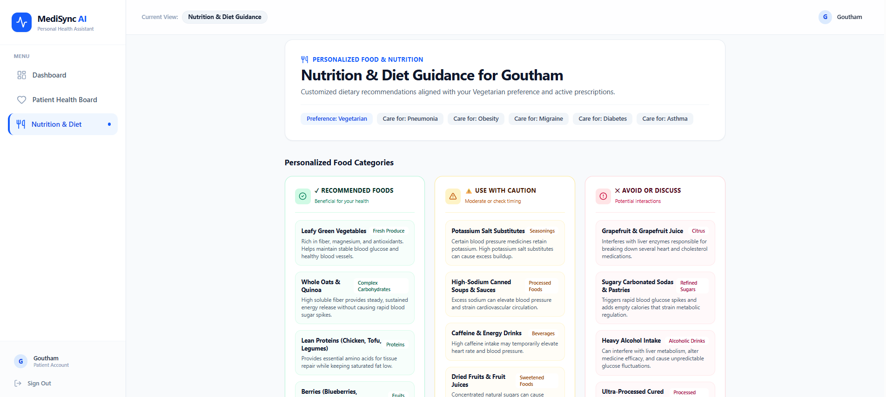
Module 3 : Medication–Diet Interaction Verification
& Personalized Nutrition

Slide 14
Module 4 : AI Decision Support, Report Generation
& Healthcare Dashboard
Integrate outputs from multiple intelligent healthcare AI agents seamlessly.
Generate comprehensive healthcare summaries using Generative AI technology effectively.
Display medication alerts through interactive healthcare dashboard visualization panels.
Present personalized diet recommendations with patient health improvement suggestions.
Generate downloadable healthcare reports supporting informed clinical decision making.
Monitor patient health status through real-time dashboard updates continuously.

Slide 15
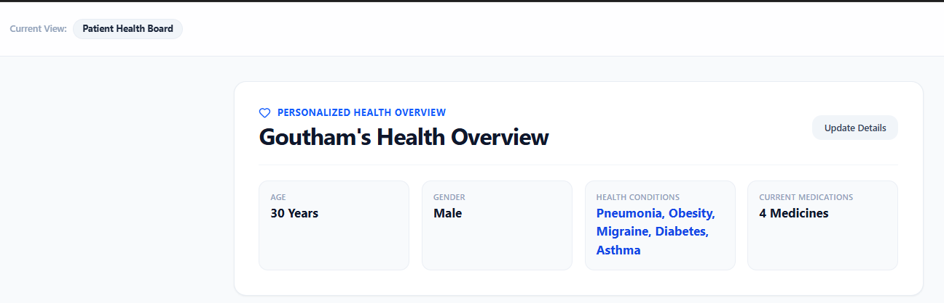
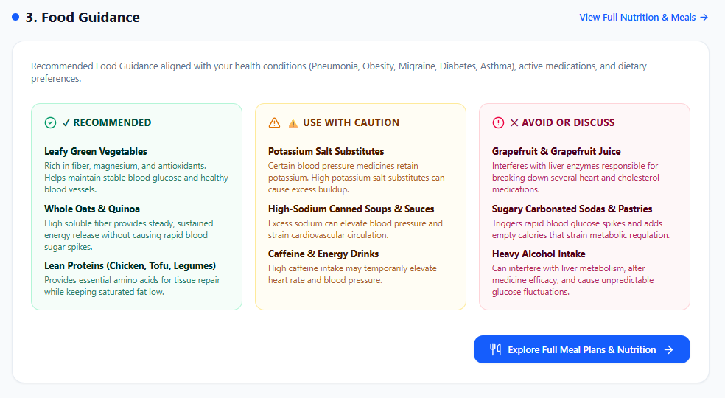
Module 4 : AI Decision Support, Report Generation
& Healthcare Dashboard

Slide 16
FUTURE SCOPE
Integrate multilingual language translation for wider accessibility and communication.
Add voice input and voice-based AI assistance for patients.
Integrate doctors into the platform for professional healthcare consultation.
Enable online doctor appointment booking based on patient requirements.
Introduce real-time health monitoring through wearable and IoT devices.
Enhance AI agents using advanced medical knowledge and personalized analytics.

Slide 17
CONCLUSION
Proposes an intelligent Multi-Agent AI healthcare decision support platform.
Detects medication conflicts and medication–diet interaction risks accurately.
Uses RAG and Gemini for reliable personalized healthcare recommendations.
Generates comprehensive healthcare reports through Generative AI technology.
Supports doctors with faster and informed clinical decision making.
Improves patient safety and overall treatment effectiveness significantly.

Slide 18
THANK YOU..!

